Slide 1
A Diagnostic approach to uterine smooth muscle tumors
Marisa R. Nucci, MD
Brigham and Women’s Hospital, Boston, MA

Slide 2
Declaração de Conflito de Interesse
Dr Nucci afirma ter / não ter conflito de interesse a declarar
Em caso afirmativo, especificar: associação financeira relevante nos últimos 12 meses e que esteja relacionada ao conteúdo da atividade científica
Exigência da RDC Nº 96/08 da ANVISA

Slide 3
Disclosure of Relevant Financial Relationships
Dr. Nucci declares he/she has no conflict(s) of interest to disclose
Specify if affirmative: any relevant financial relationship WITH COMMERCIAL INTERESTS within the past 12 months, which relates to the content of this educational activity and creates a conflict of interest
RDC Nº 96/08 da ANVISA

Slide 4
Objectives
Review changes in WHO 2020 regarding uterine leiomyoma
Review criteria for classifying smooth muscle tumor with atypia

Slide 5
Case 1: Clinical History
47-year-old woman with history of uterine fibroids and breast cancer presents with pelvic pain. Ultrasound shows a pelvic mass. At surgery, a 5 cm right broad ligament fibroid was resected (15 sections submitted for histologic review).

Slide 6
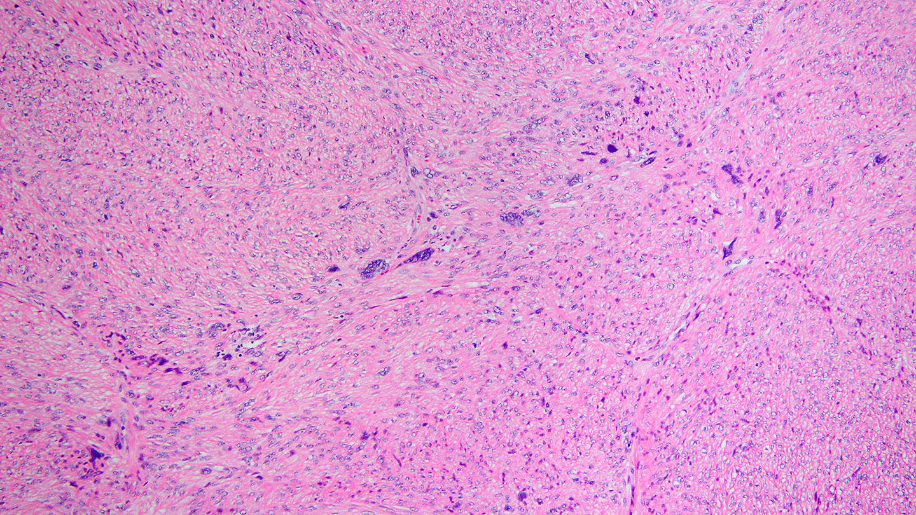

Slide 7
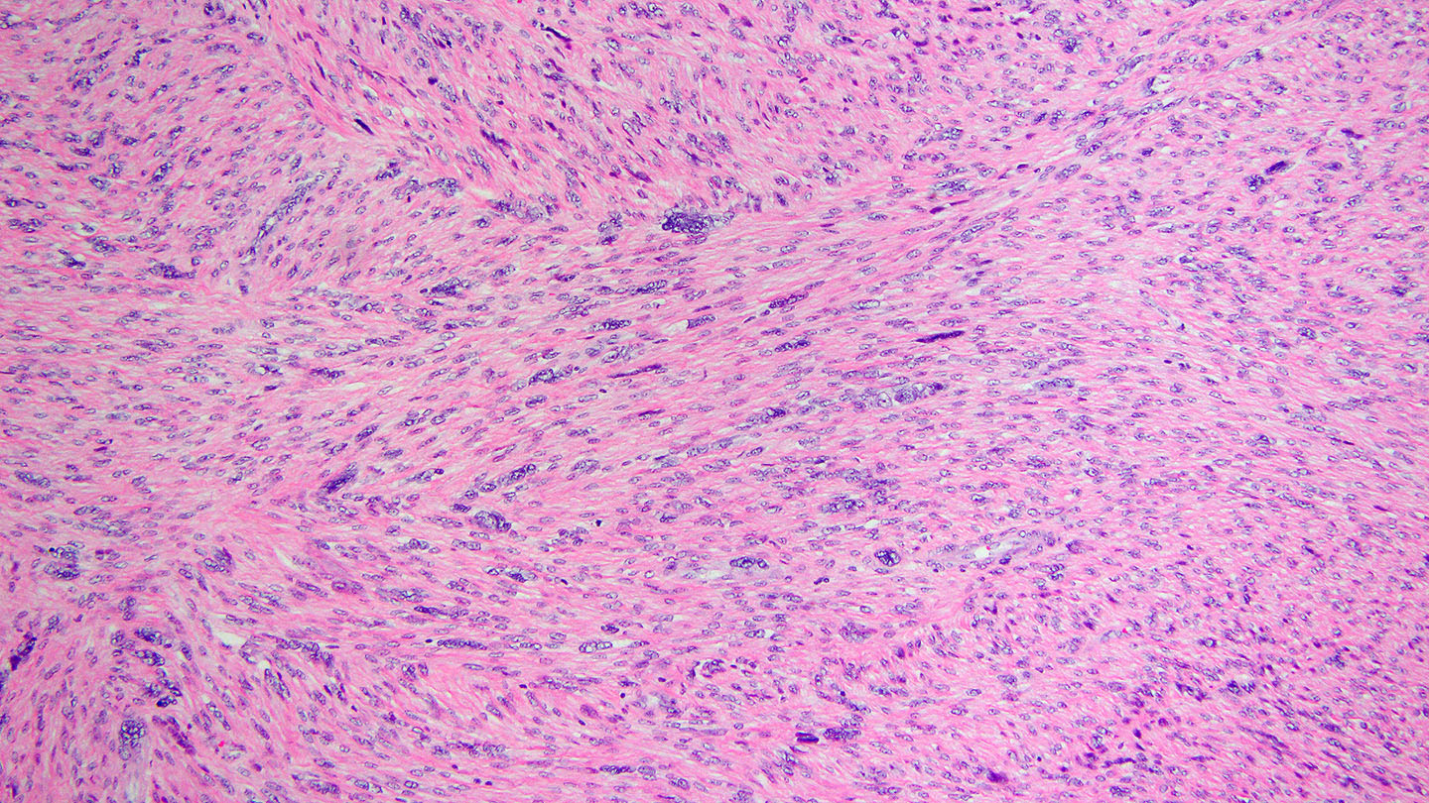

Slide 8
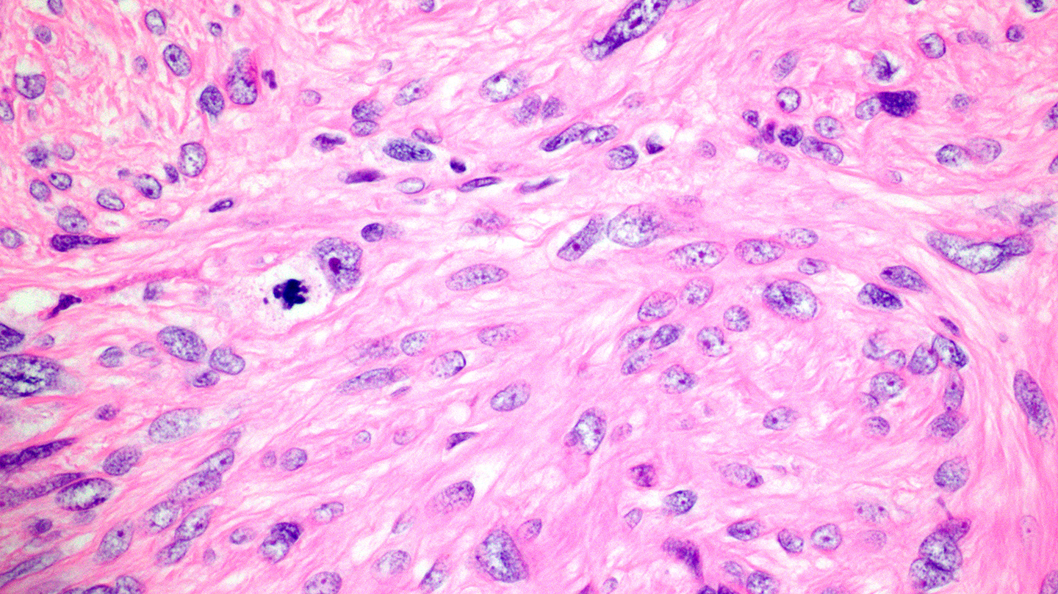

Slide 9
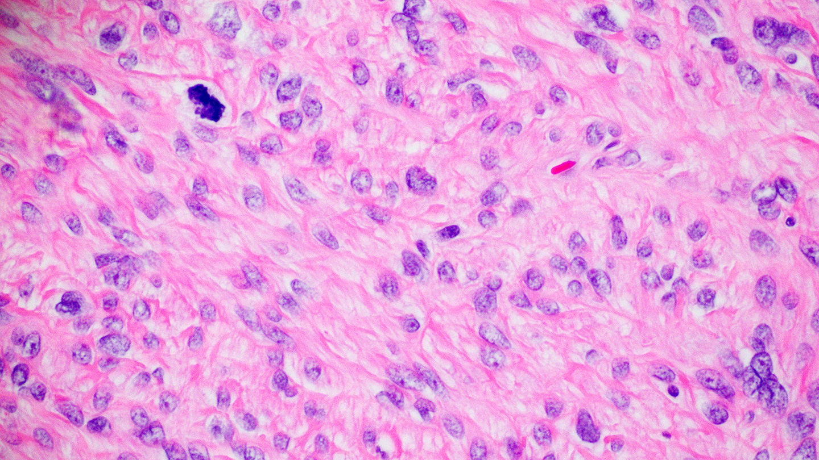

Slide 11
Leiomyoma Variants WHO 2014 versus WHO 2020
Cellular leiomyoma
Leiomyoma with bizarre nuclei
Mitotically active leiomyoma
Hydropic leiomyoma
Apoplectic leiomyoma
Lipomatous leiomyoma (lipoleiomyoma)
Epithelioid leiomyoma
Myxoid leiomyoma
Dissecting (cotyledenoid) leiomyoma
Diffuse leiomyomatosis
Intravenous leiomyomatosis
Metastasizing leiomyoma
Cellular leiomyoma
Leiomyoma with bizarre nuclei
Fumarate hydratase-deficient leiomyoma
Mitotically active leiomyoma
Hydropic leiomyoma
Apoplectic leiomyoma
Lipomatous leiomyoma (lipoleiomyoma)
Epithelioid leiomyoma
Myxoid leiomyoma
Dissecting (cotyledenoid) leiomyoma
Diffuse leiomyomatosis

Slide 12
Leiomyoma Variants WHO 2020
Cellular leiomyoma
Leiomyoma with bizarre nuclei
Fumarate hydratase-deficient leiomyoma
Mitotically active leiomyoma
Hydropic leiomyoma
Apoplectic leiomyoma
Lipomatous leiomyoma (lipoleiomyoma)
Epithelioid leiomyoma
Myxoid leiomyoma
Dissecting (cotyledenoid) leiomyoma
Diffuse leiomyomatosis

Slide 13
Uterine Smooth Muscle Tumors with Atypical Nuclei
Leiomyosarcoma
Smooth muscle tumor of uncertain malignant potential
Leiomyoma with bizarre nuclei (atypical leiomyoma, symplastic leiomyoma, leiomyoma with symplastic change)
“contain bizarre cells arranged in multifocal to diffuse distribution in a background of typical leiomyoma”
“the bizarre cells may be mononucleated or multinucleated and may have eosinophilic or globular cytoplasm, smudged chromatin, and nuclear pseudo-inclusions”
“mitotic activity is typically low (<5 per 10 HPF) but karyorrhectic nuclei, which may mimic atypical mitotic figures, are not uncommon”
Notes:
Atypical bizarre nuclei can be seen in benign, malignant and uncertain

Slide 14
Bell, S. W., Kempson and Hendrickson. (1994). "Problematic uterine smooth muscle neoplasms: A clinicopathologic study of 213 cases" American Journal of Surgical Pathology 18: 535-558.
Identified 3 important features to evaluate in smooth muscle tumors
Atypia (none-mild vs moderate-severe; focal vs diffuse)
Mitotic count (mitotic figures/10 hpf) with a 10 mf/10 hpf cutoff
Necrosis (tumor cell necrosis vs hyaline/infarct like necrosis)
Atypical leiomyomas have significant atypia but no tumor cell necrosis and < 10 mf/10 hpf
Notes:
With regard to LMS

Slide 15
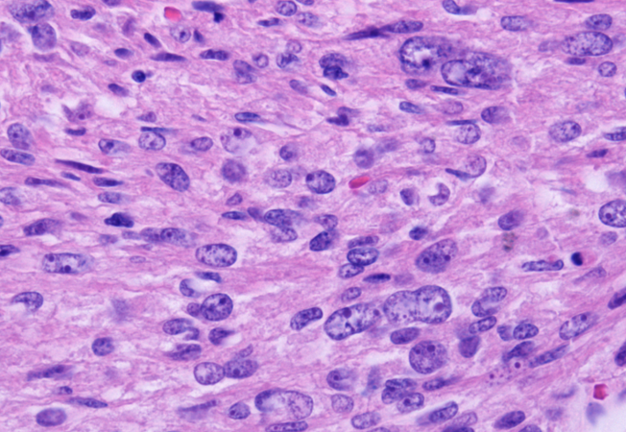
Evaluation of Cytologic Atypia
“Significant” cytologic atypia notable at low power (10X)
Nuclear enlargement, coarse chromatin, multilobation, variation in nuclear shape, multinucleation
10X
Notes:
By general consensus, atypia is considered significant when it is notable at low power (i.e. 10X objective). Mild nuclear changes usually first noted at high magnification, do not predict clinical or biologic behavior (Bell AJSP 1994). Atypia may be manifested as nuclear enlargement..

Slide 16
Evaluation of Cytologic Atypia
“Significant” cytologic atypia notable at low power (10X)
Mild nuclear changes (usually first noted at high magnification), do not predict clinical or biologic behavior
Bell et al, AJSP 1994
Notes:
By general consensus, atypia is considered significant when it is notable at low power (i.e. 10X objective). Mild nuclear changes usually first noted at high magnification, do not predict clinical or biologic behavior (Bell AJSP 1994). Atypia may be manifested as nuclear enlargement..

Slide 17
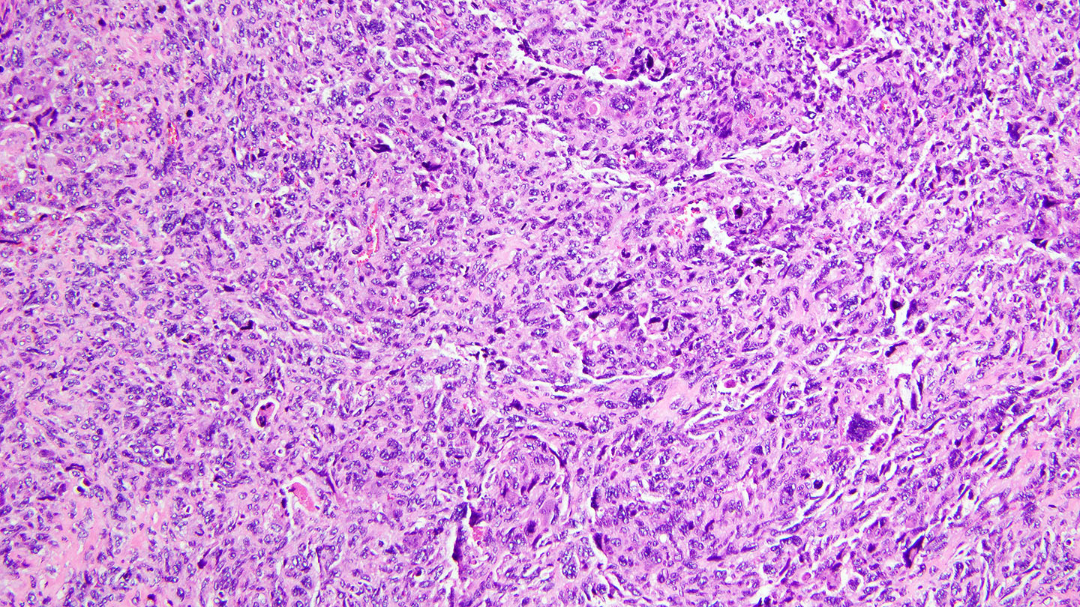
Significant Cytologic Atypia at Low Power (10X)

Slide 18
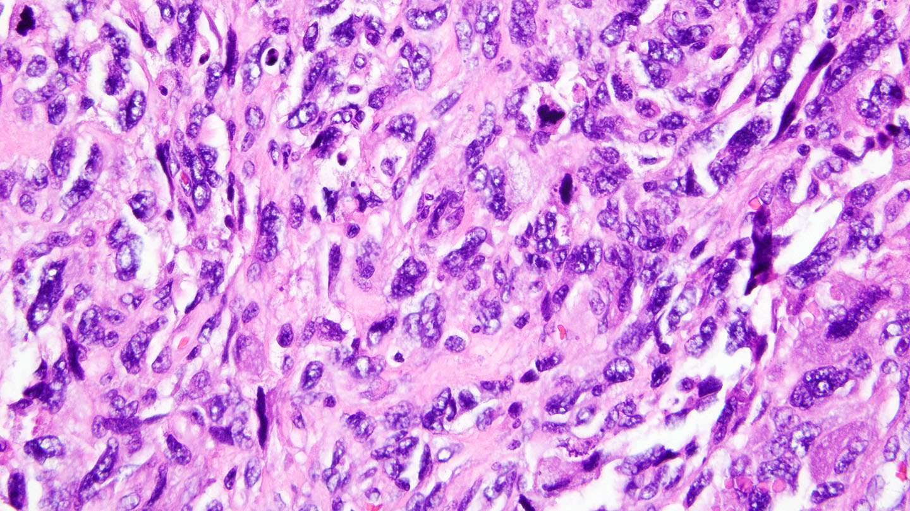
Nuclear enlargement, variation in nuclear shape and contours, coarse chromatin

Slide 19
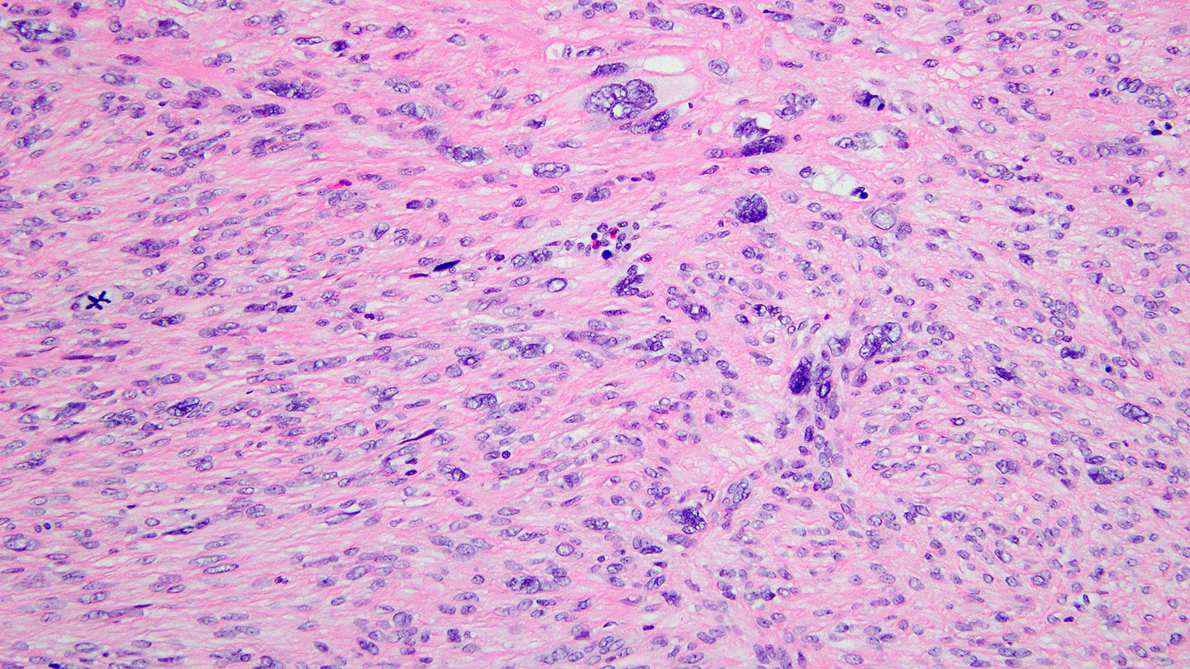
Multilobation, multinucleation

Slide 20
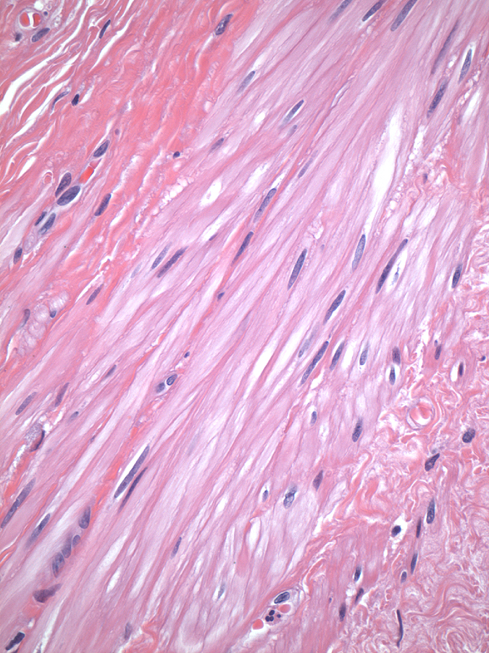
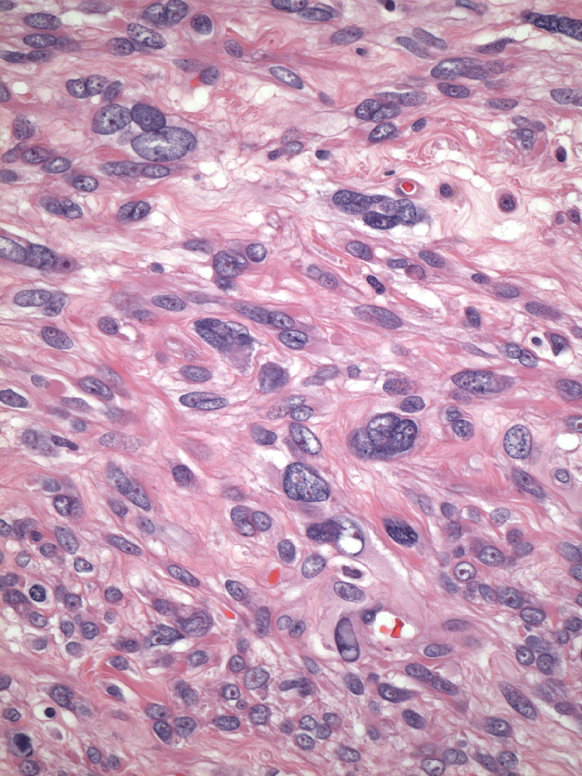
MYO
Nuclear Enlargement
LMS
Notes:
So for example, in comparison to the nuclei of benign smooth muscle cells, which have a fairly uniform spindle shape with bland, dispersed chromatin, significant nuclear atypia may be manifest as nuclear enlargement, typically also associated with irregular nuclear contour as seen here
Labs are different so assess in comparison to myometrium

Slide 21
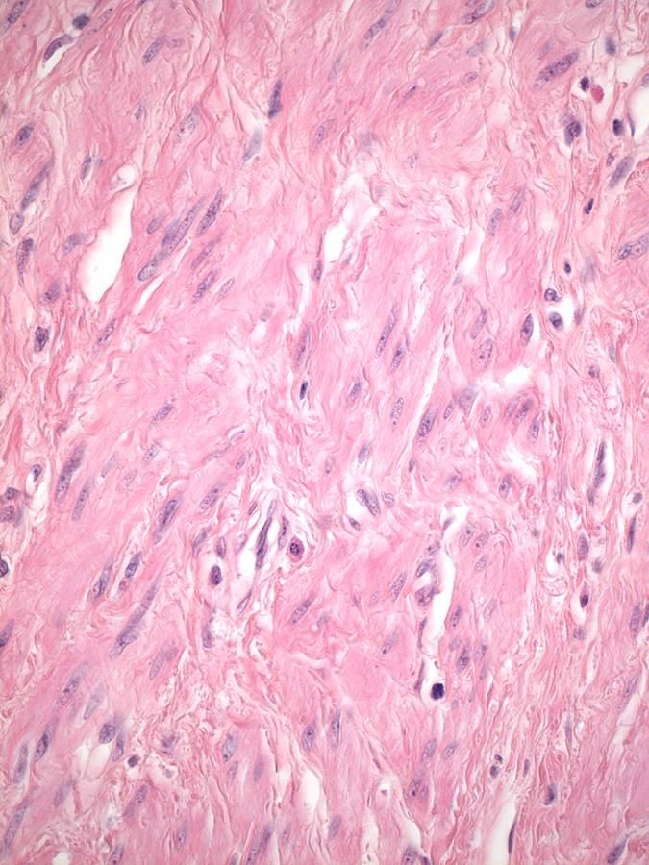
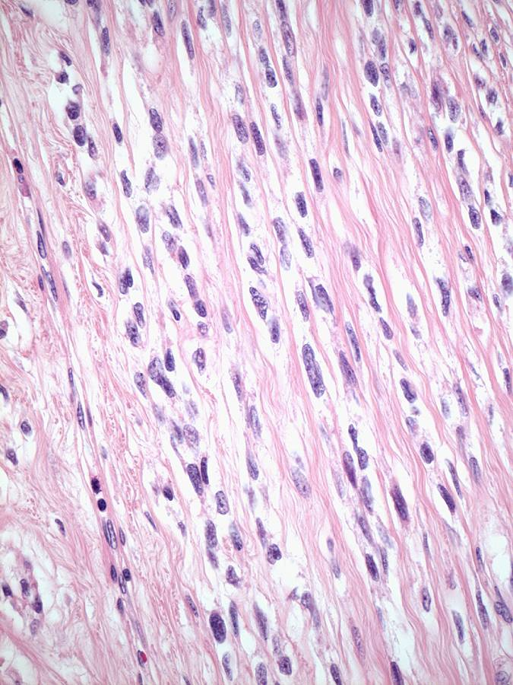
MYO
Coarse chromatin
LMS
Notes:
Or as hyperchromasia with coarsening of the chromatin texture as seen here – in this example there is only a modest increase in nuclear size

Slide 22
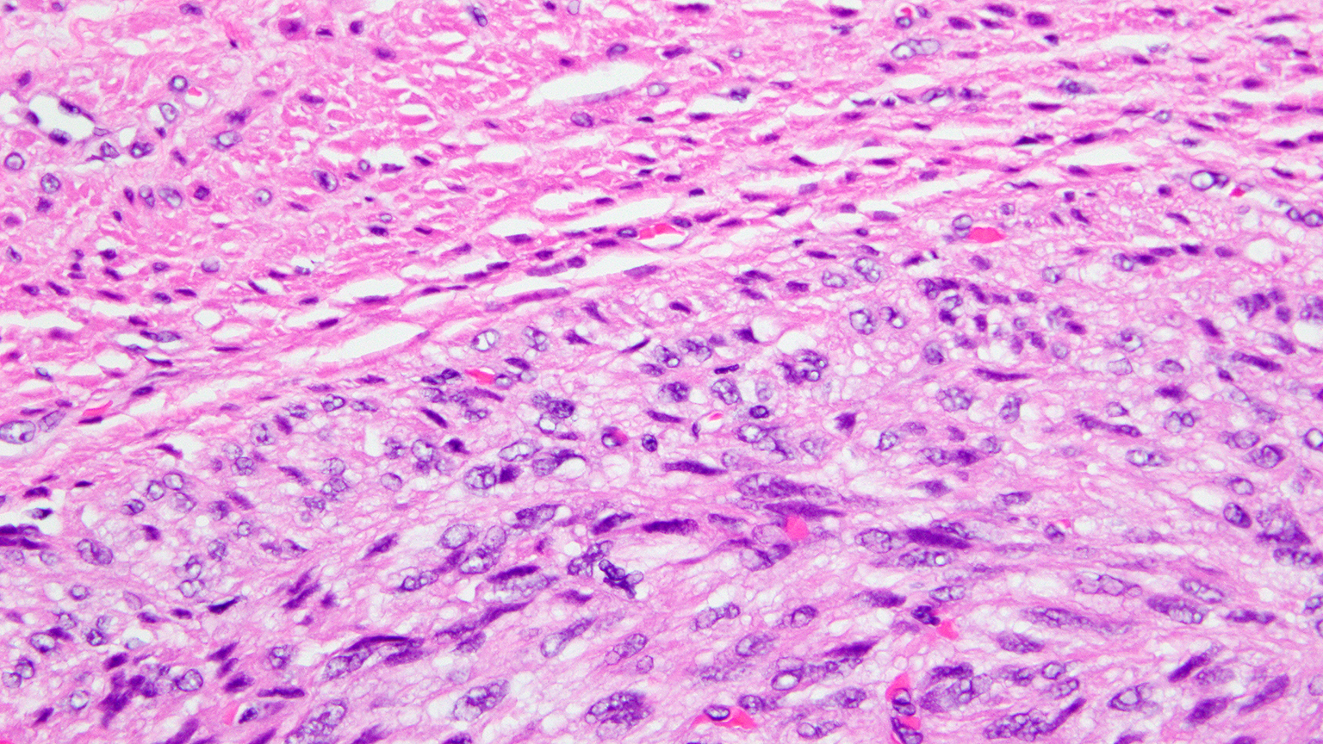
Notes:
40X

Slide 23
Distribution of Cytologic Atypia
Diffuse
Multifocal – Zonal Pattern
Multifocal - Dispersed
Notes:
Although the distribution of atypia is not formally used as a criterion in the diagnostic algorithm for LMS, it is worth noting that the distribution of cytologic atypia in LMS can be variable. Most commonly it is present diffusely; however it can be multifocal and when multifocal can either have a zonal pattern or a pattern in which the atypia is dispersed throughout the tumor

Slide 24
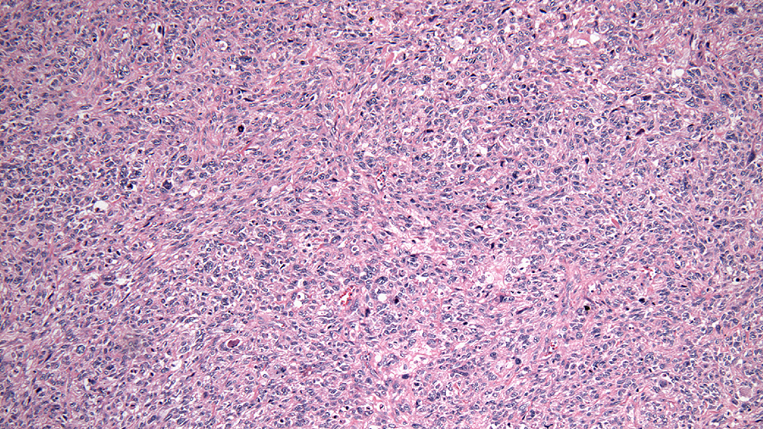
Diffuse Atypia (10X)

Slide 25
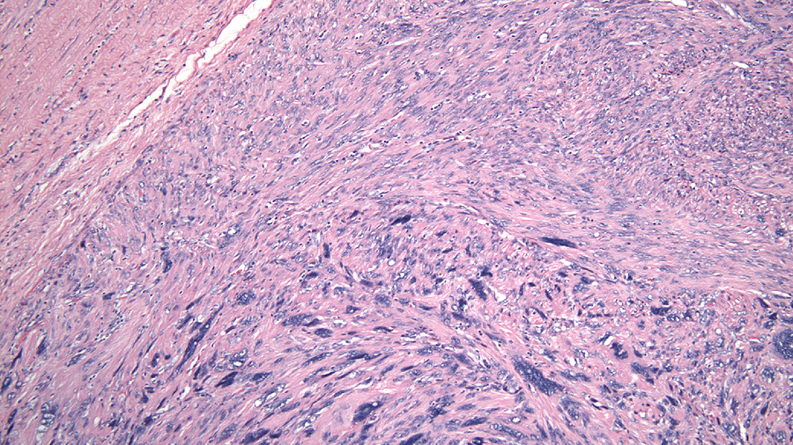
Multifocal Atypia – Zonal (10X)
Notes:
In this tumor, which also showed CTCN, the atypia was multifocal but had a zonal pattern (reminiscent of a symplastic leiomyoma) underscoring 1) the importance of assessing more than one histologic feature when classifying uterine SMTs and 2) LMS can have a similar zonal distribution of atypia like symplastic leiomyomata

Slide 26
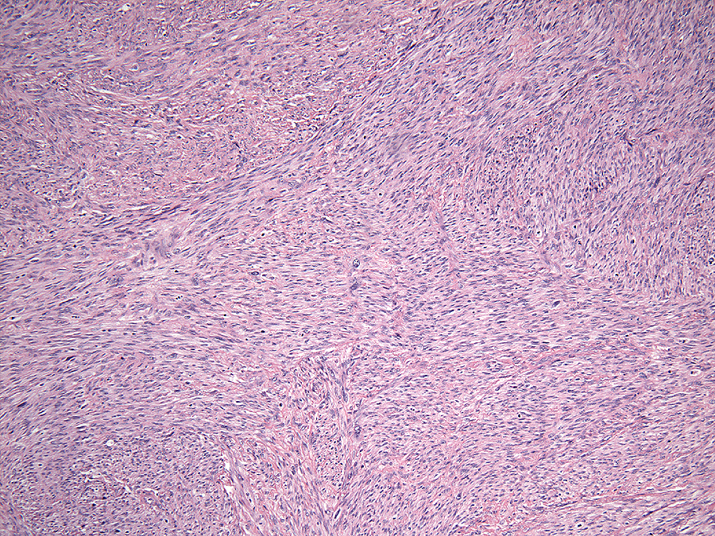
Multifocal Atypia – Dispersed (10X)
Notes:
Here the enlarged nuclei are dispersed throughout this LMS which had a mitotic count > 10 per 10 HPFs

Slide 27
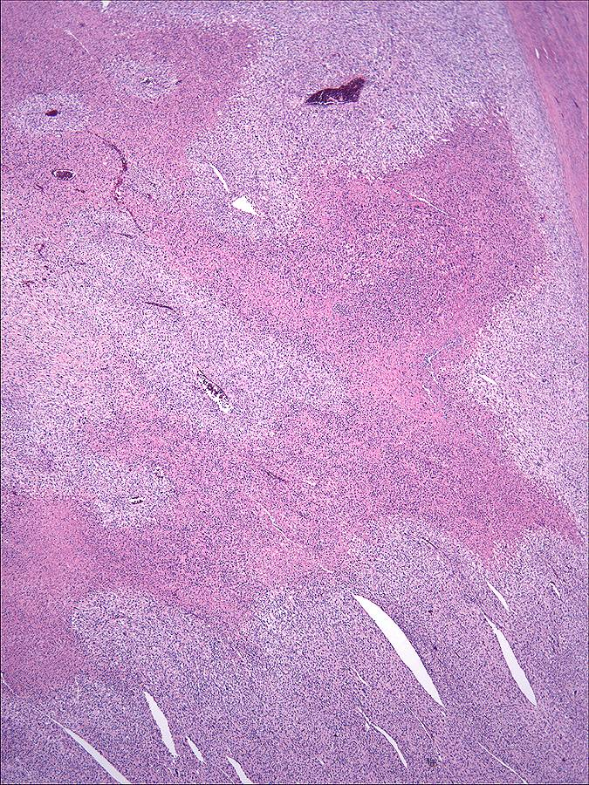
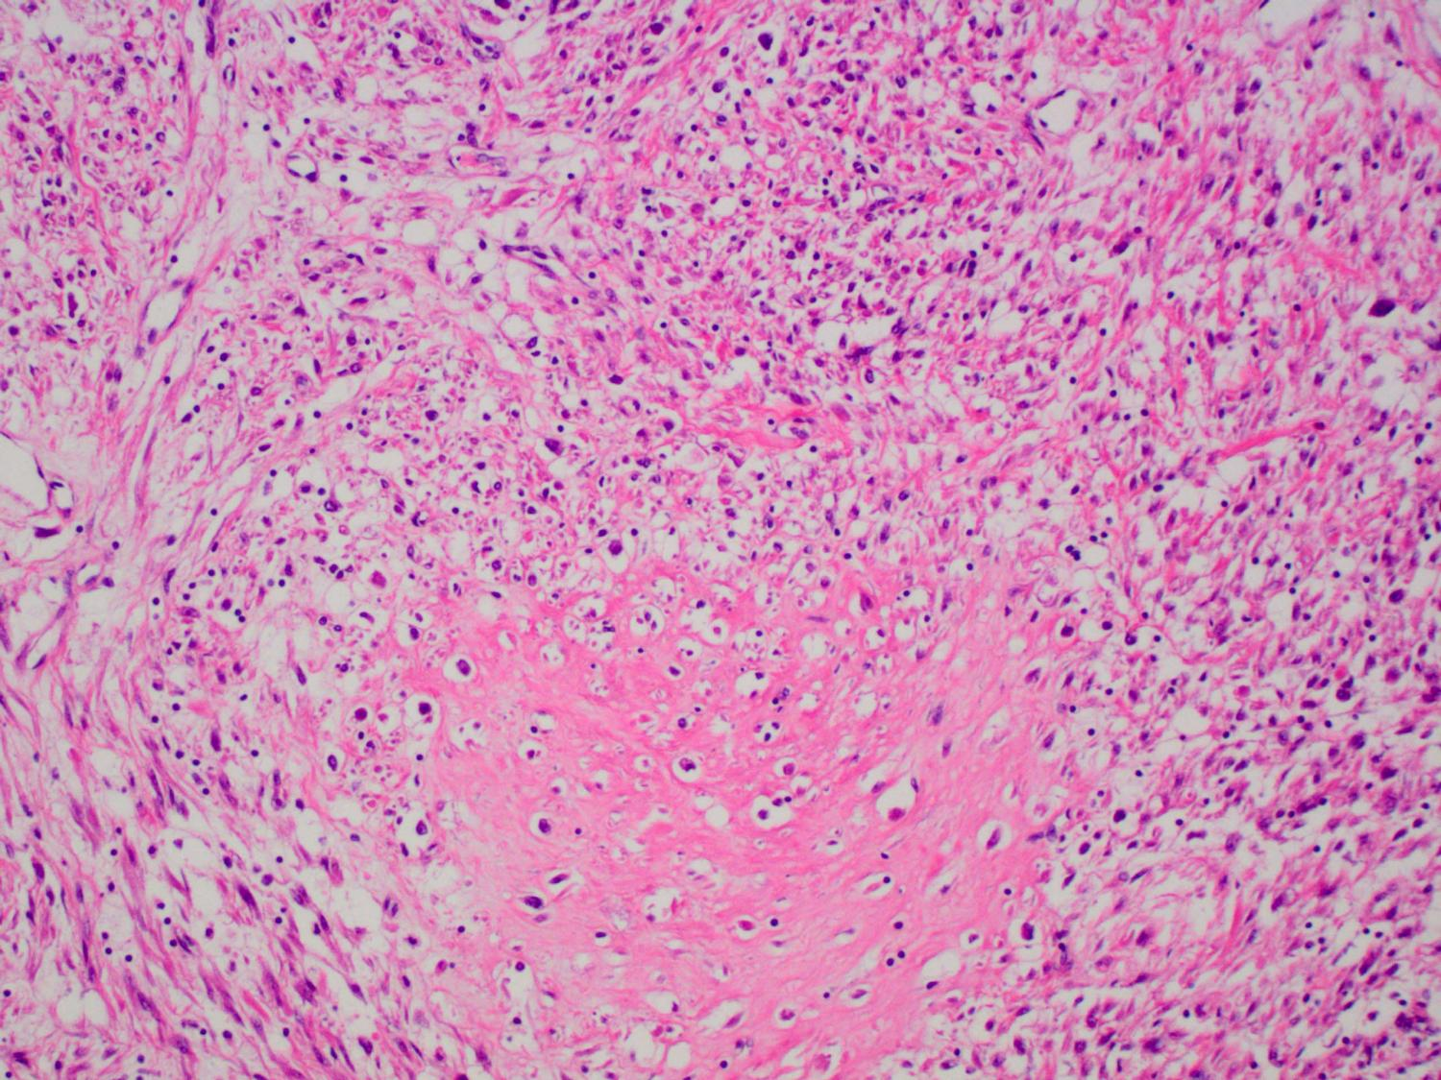
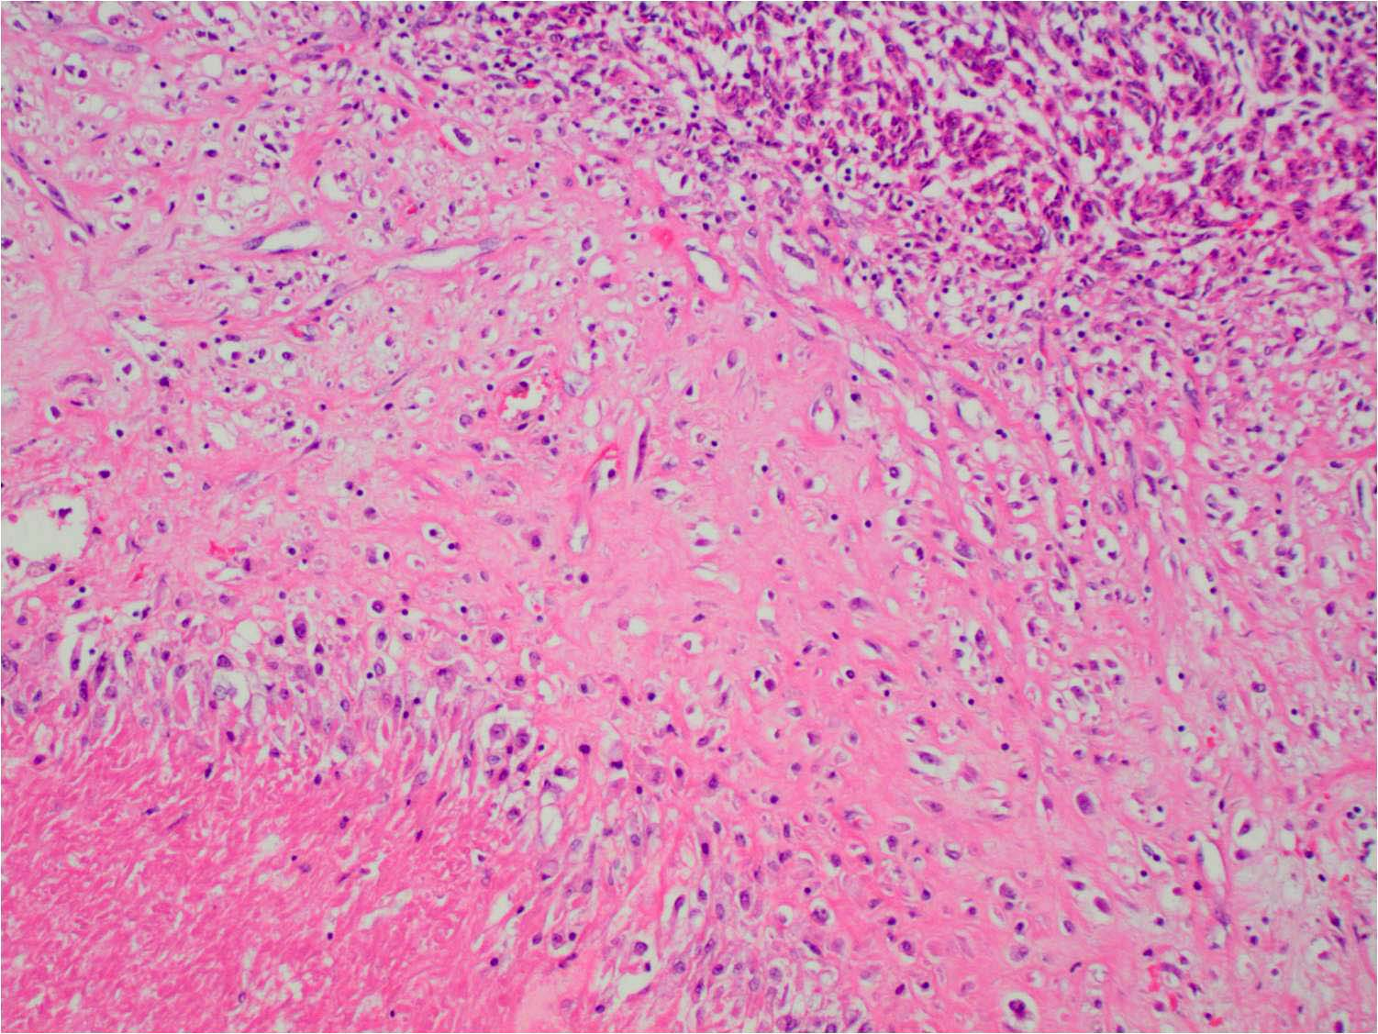
Bell et al: Generally easy to differentiate hyaline necrosis from tumor cell necrosis
Notes:
Coagulative necrosis where zones of ghost tumor cells were seen in abrupt transition from viable tumor cells were seen in one case. Of note, this subject did not have an adverse outcome within 4 ½ years.
27

Slide 28
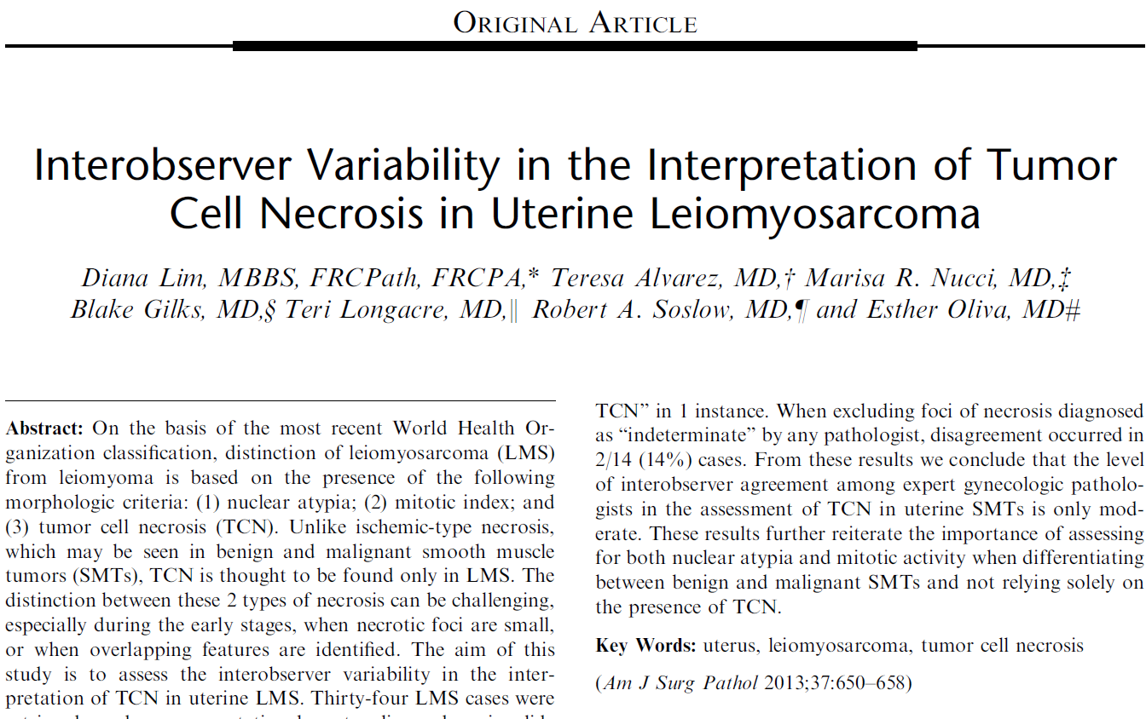
Full agreement in 35%
Partial agreement (4 or 5) in 47%
No agreement in 18%

Slide 29
Evaluation of Necrosis
Multifocal
“Geographic” appearance with angulated outline
Sharp transition (< 5 cells)
Atypical “ghost” cells
Notes:
Of the 3 principal histologic features evaluated in the classification of SMTs, tumor necrosis perhaps carries the greatest weight in the determination of malignancy. Malignancy associated necrosis must be distinguished however from benign degenerative type changes. Tumor necrosis associated with malignancy aka coagulative tumor cell necrosis has the following features, listed here, which serve to distinguish it from benign SMTs.

Slide 30
Geographic Appearance
Notes:
First, CTCN is described as being geographic because the contour of the interface with viable tumor is often irregular or angulated like islands on a map, and in this case similar to England

Slide 31
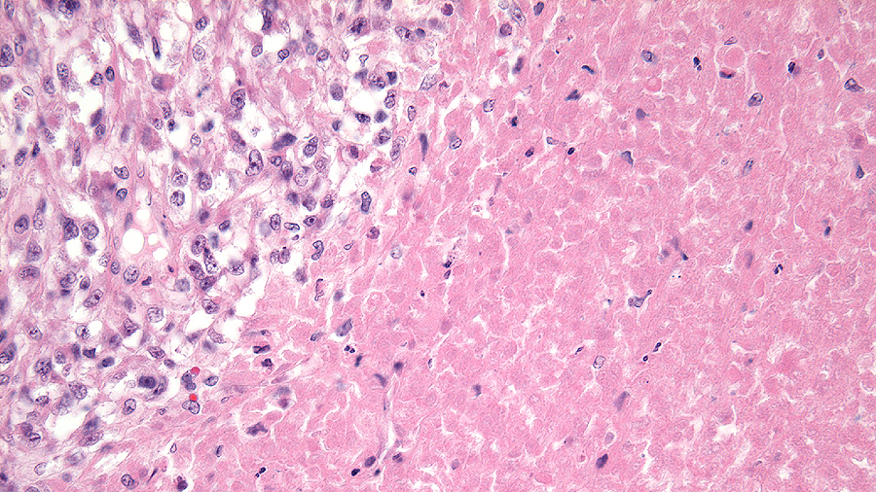
Sharp Transition

Slide 32
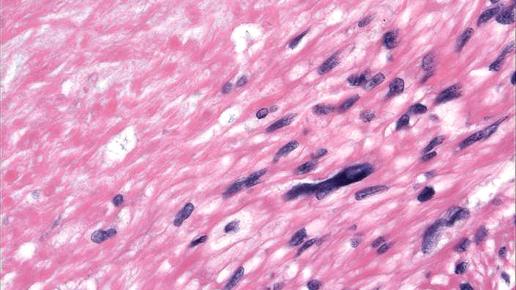
Sharp Transition
Notes:
At most usually spans the scale of a few cells as seen here.

Slide 33
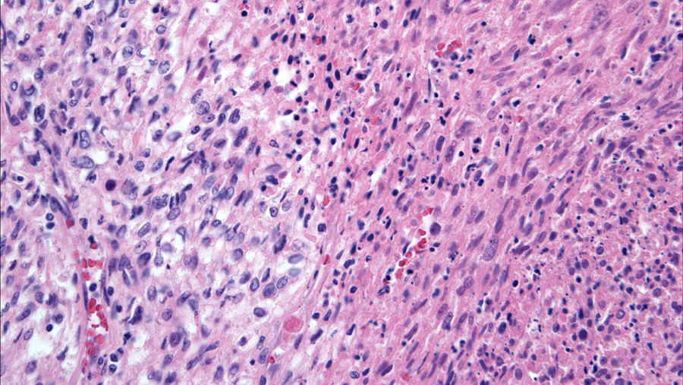
Atypical Ghost Cells
Notes:
In addition, in CTCN, atypical ghost cells may be seen in the areas of malignant tumor necrosis illustrated here

Slide 34
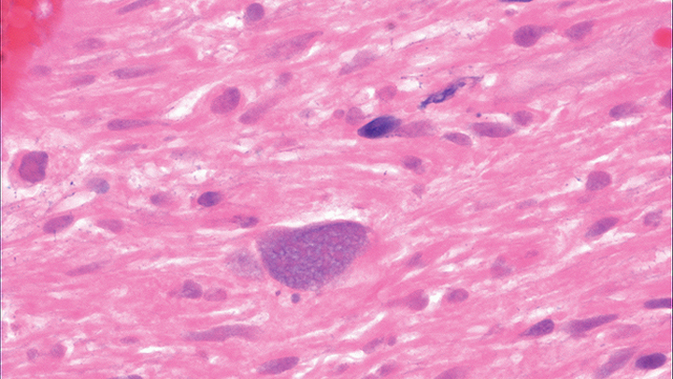
Atypical Ghost Cells
Notes:
Atypical ghost cells are necrotic cells in which the cell borders and cytologic atypia are still apparent within the necrotic focus

Slide 35
Tumor Necrosis vs. Degeneration
Coagulative Tumor Cell Necrosis
Ischemic Necrosis
Multifocal
Irregular, “map-like” contour
Sharp transition
Atypical “ghost” cells
Fibroblastic repair uncommon
Single, often central
Smooth, rounded contour
Blurred transition
Bland “ghost” cells
Fibroblastic repair
Notes:
A comparison of the features distinguishing CTCN vs ischemic necrosis is listed here. In contrast to CTCN, IN is usually a single focus that is often centrally located. The border in IN is typically smooth with a rounded contour as opposed to CTCN which characteristically has an irregular, “map” like contour. The necrotic cells in IN are benign appearing and have a bland appearance and at the edge of IN a fibroblastic repair may be seen which is uncommon in CTCN

Slide 36
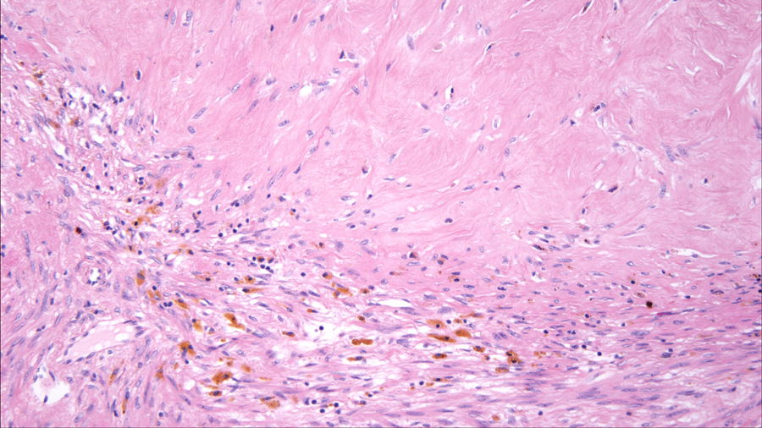
Smooth Rounded Contour
Notes:
This image shows the smooth rounded contour associated with degenerative changes and central hyalinization in a benign SMT

Slide 37
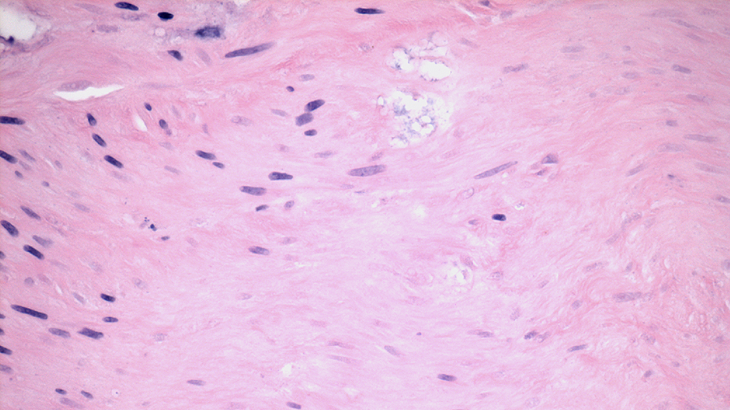
Bland Ghost Cells
Notes:
Within the necrotic area associated with ischemic degeneration, the ghost cells have a bland, non-atypical appearance.

Slide 38
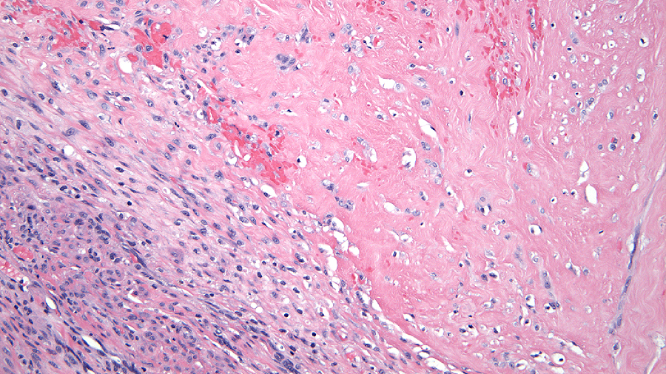
Fibroblastic Repair
Notes:
Another feature is the presence of a zone of fibroblastic repair as seen here.

Slide 39
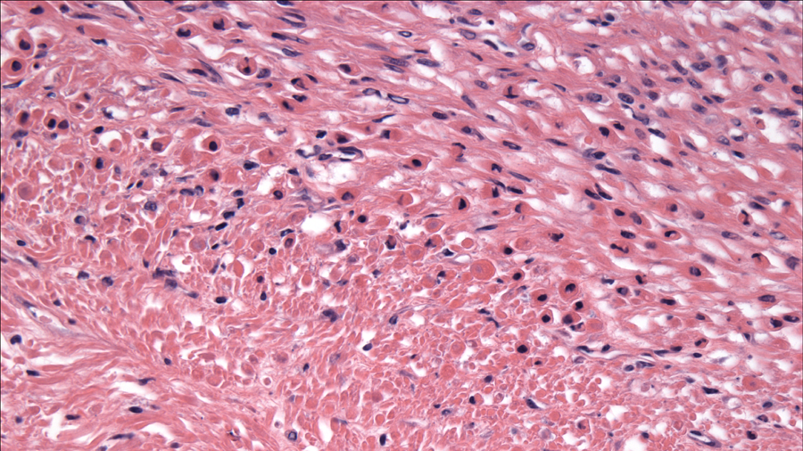
Blurred Transition
Notes:
In ischemic necrosis the interface between viable and non viable cells is blurred and occurs over a broad zone as you can see here.

Slide 40
Notes:
Here is an example of a smooth muscle tumor showing a lot of hemorrhage and necrosis. This case provides two teaching points; 1) do not base diagnosis on gross, must always histologically confirm 2) context is important. Ischemic/degenerative changes can sometimes produce a very worrisome gross appearance mimicking a malignancy as it did in this case; however notice that the hemorrhage and necrosis seem to be predominantly located in the lower half of the specimen

Slide 41
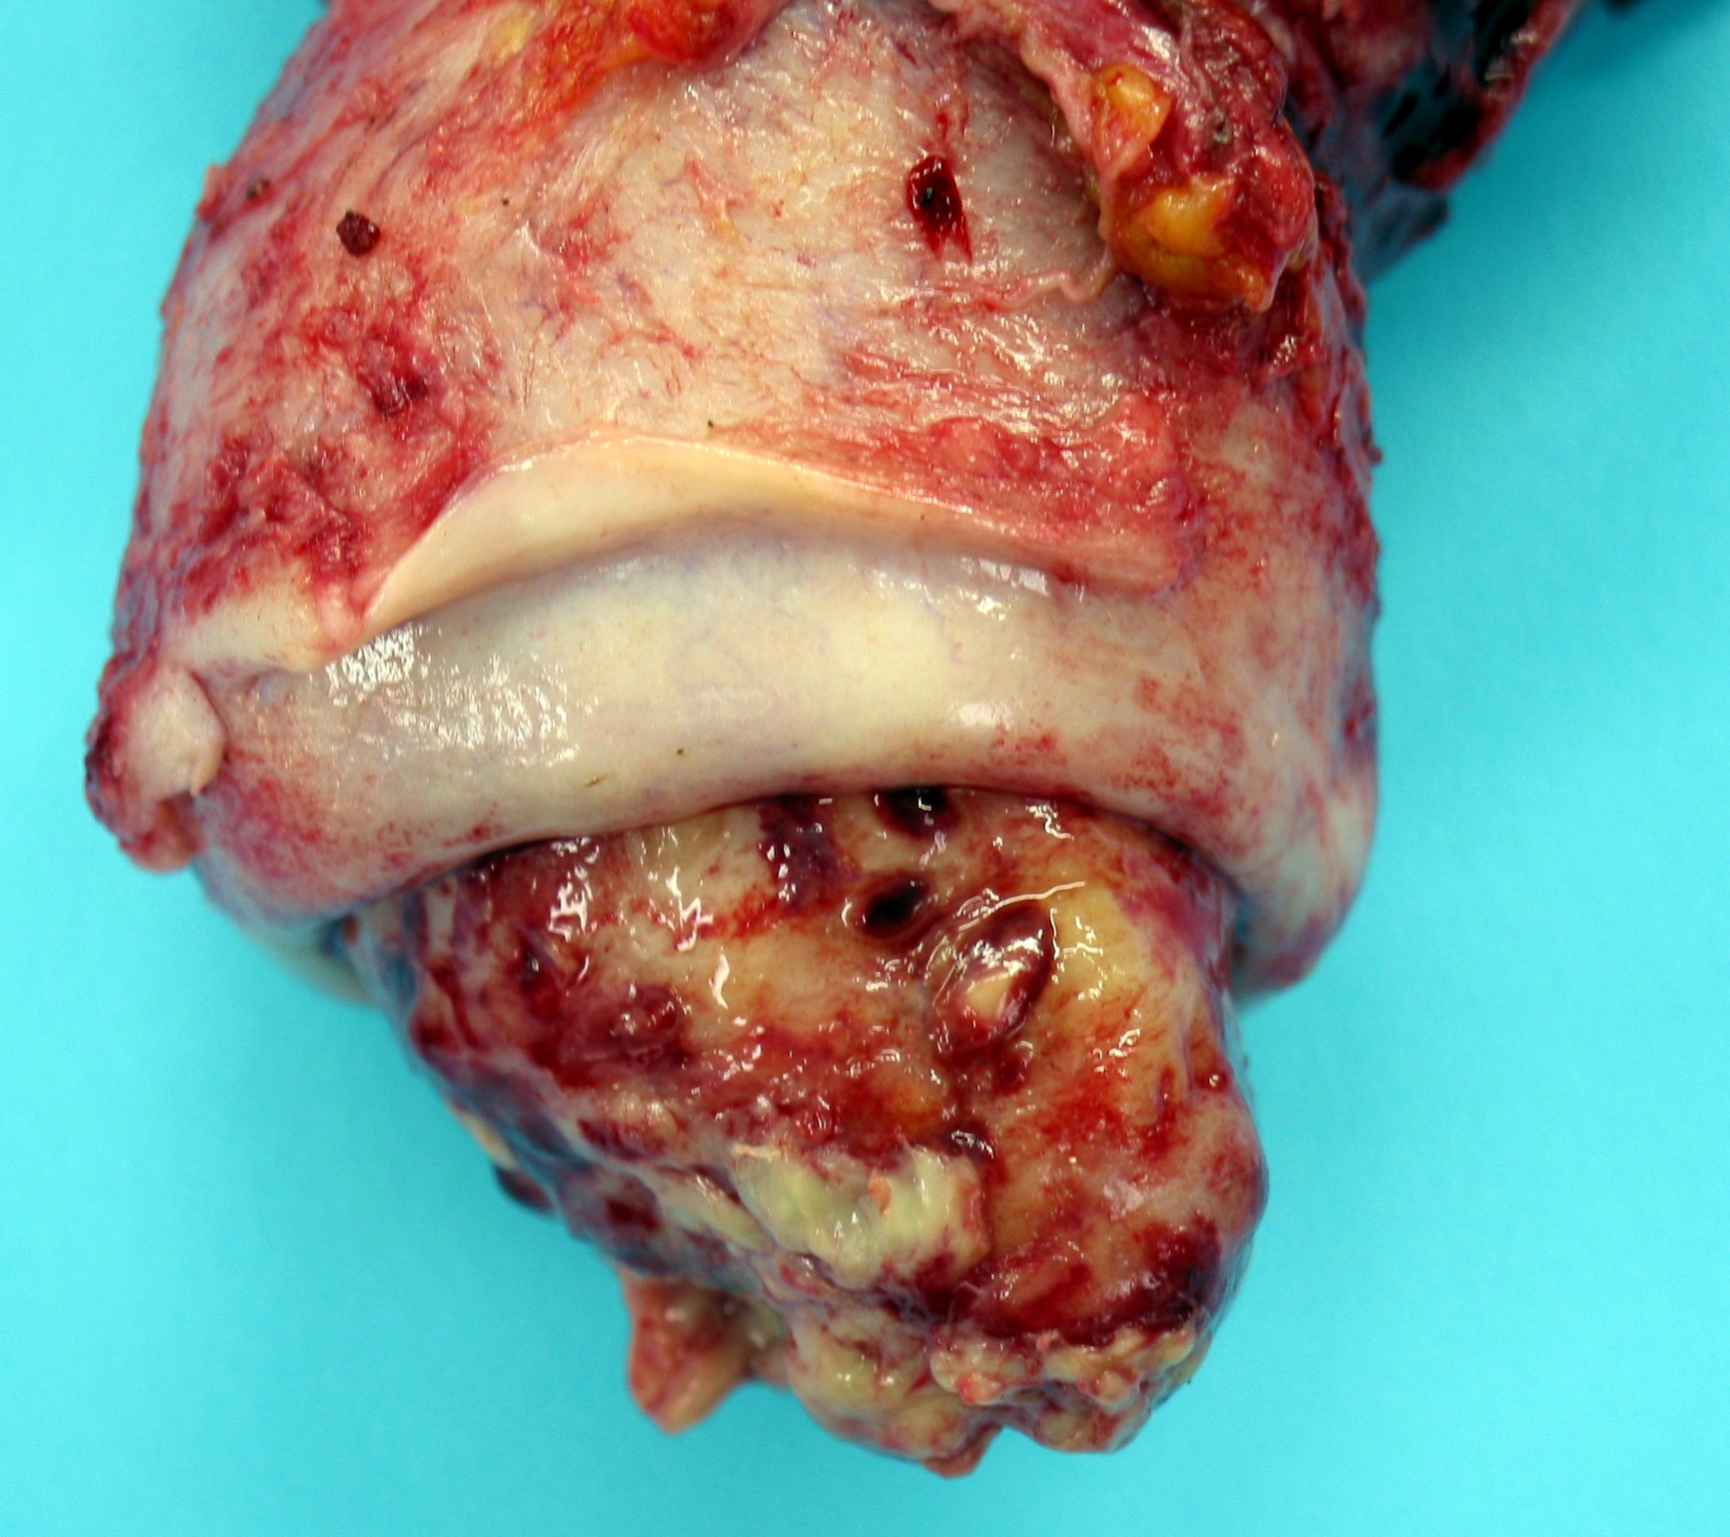
Degeneration Mimicking Malignancy
Notes:
And in fact this case represents a benign leiomyoma with strangulation of its lower half as it protruded through the cervical os; shown to you as a reminder of the importance of careful clinico-pathologic correlation.

Slide 42
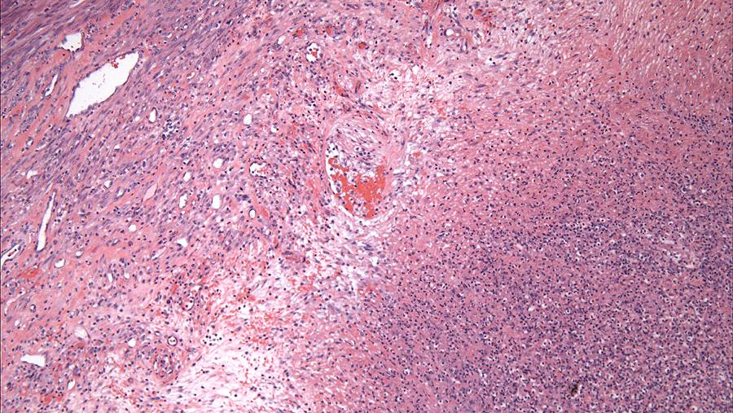

Slide 43
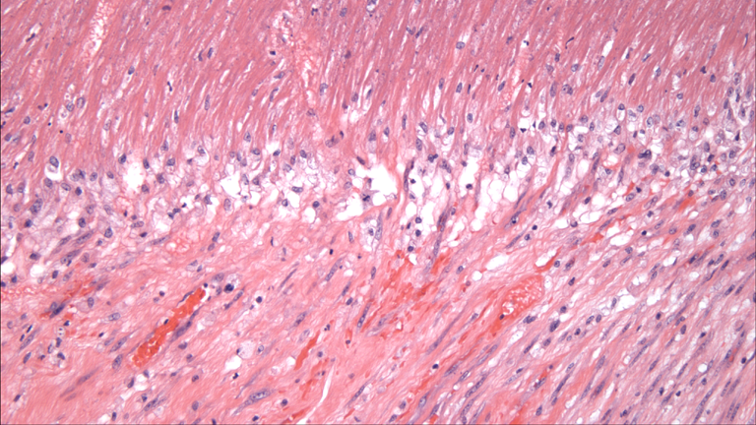

Slide 44
Test Your Knowledge!

Slide 45
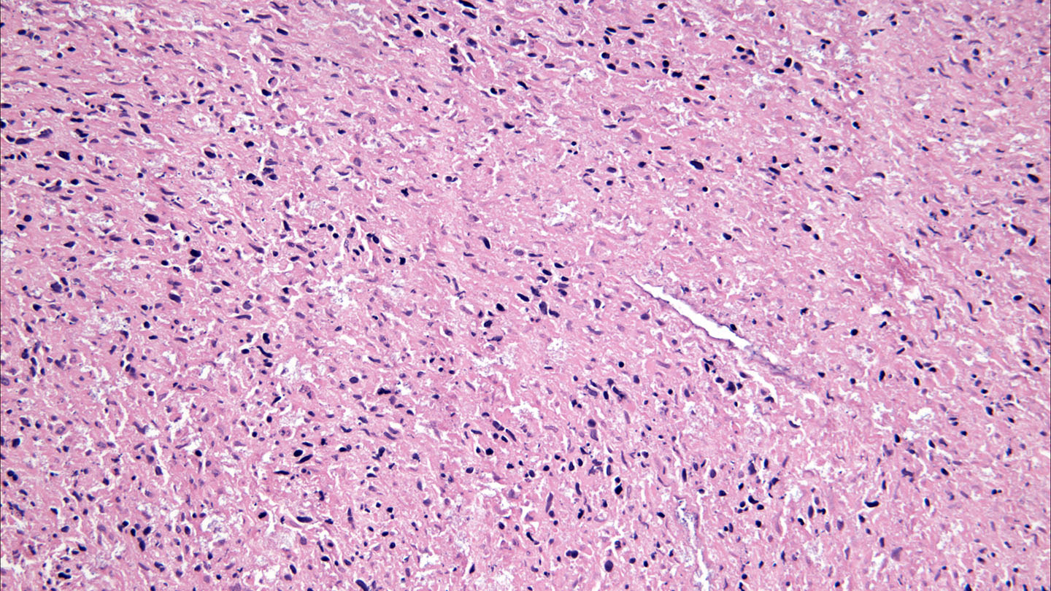
Coagulative Necrosis – YES or NO?
Notes:
NO - LMS can have ischemia too!

Slide 46
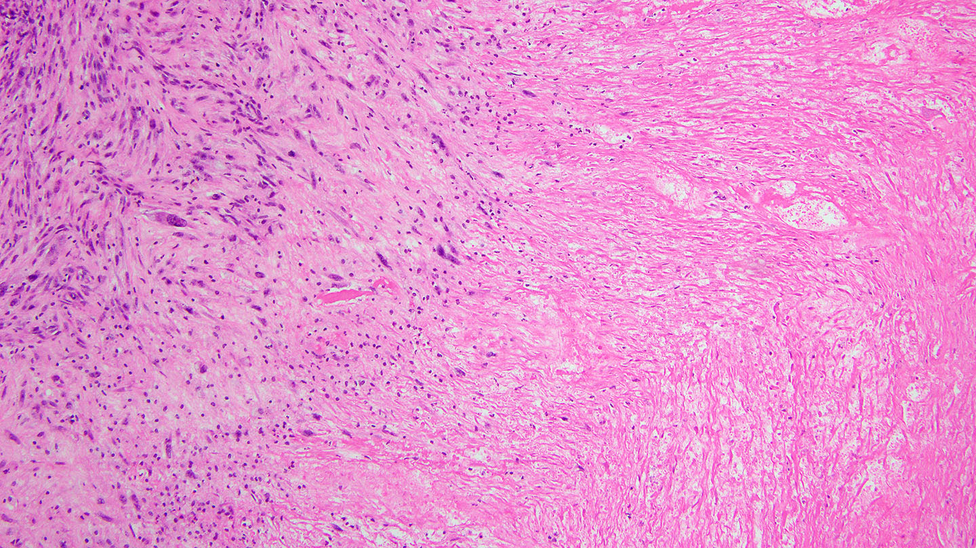
Coagulative Necrosis – YES or NO?
Notes:
infarct

Slide 47
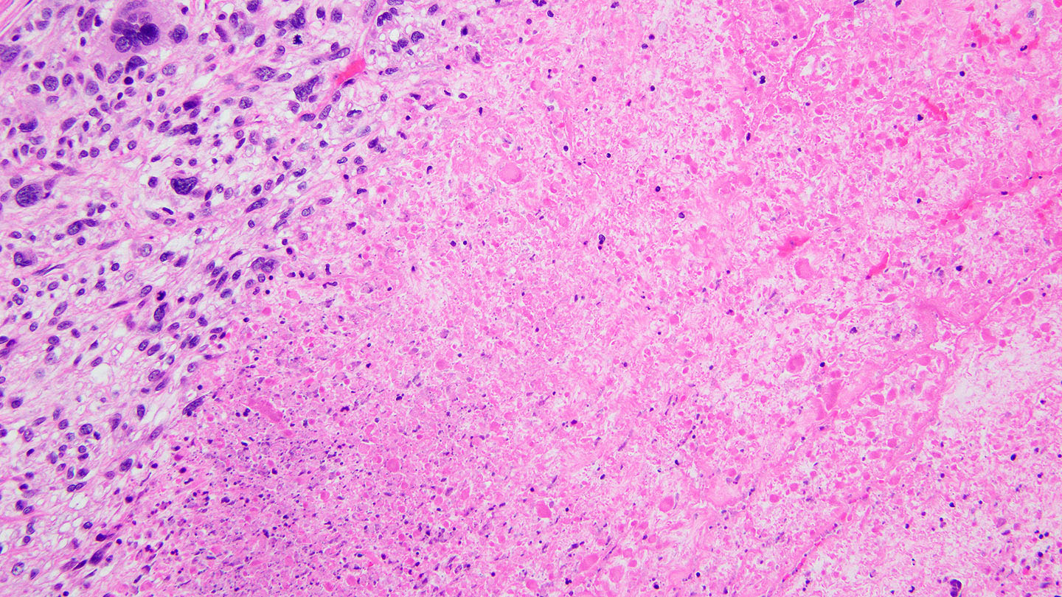
Coagulative Necrosis – YES or NO?

Slide 48
Evaluation of Mitotic Activity
Count adjacent high-power fields (40X objective)
Count at least 30-50 fields
Scan for proliferative “hot spots””
Notes:
Mitotic activity is another histologic feature that is assessed when classifying SMTs and evaluation of this parameter typically entails the following: 1) mitoses are counted in 10 adjacent high power fields using the 40X objective. 2) While there is no specific protocol, it is reasonable to count at least 30 fields. 3) While an average mitotic count is often reported, a more clinically and diagnostically useful count is the “highest number” count i.e. the greatest number of mitoses identified in 10 hpf after counting at least 30-50 fields. I prefer to scan at low power to identify proliferative “hot spots” and then move to 40X to begin an official count.

Slide 49
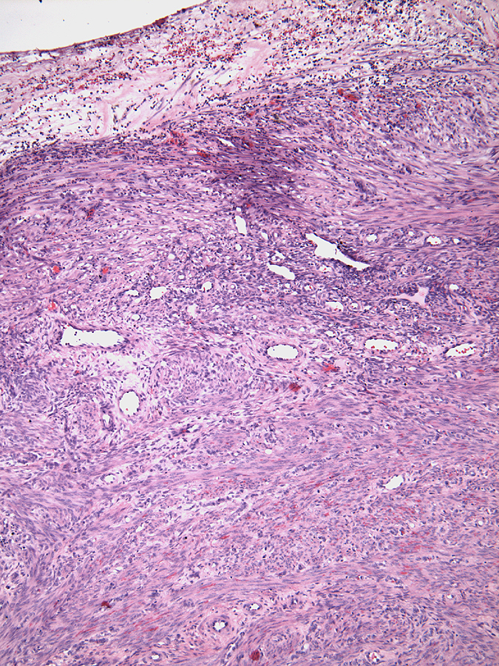
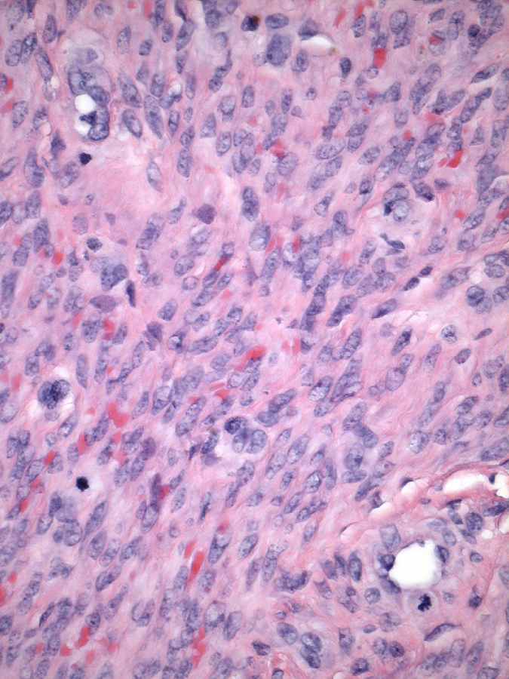
Increased Mitotic Activity
Beneath Surface Ulceration
Notes:
It is important to also remember that mitotic activity can be increased in benign smooth muscle tumors around areas of degeneration or beneath surface ulceration as it was here in this prolapsing submucous myoma.

Slide 50
POTENTIAL PITFALL
Mitotic figure vs. pyknotic nucleus
Notes:
An important caveat is that each potential mitotic figure must be carefully evaluated to be sure it is not a degenerating cell as one of the major pitfalls in evaluating mitotic activity is distinguishing a mitotic figure from a pyknotic nucleus

Slide 51
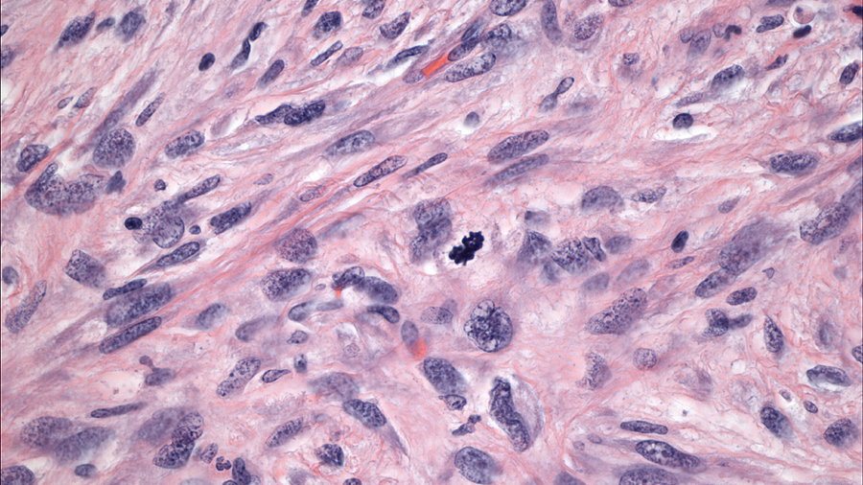
Bona fide mitotic figure: distinct chromosomes visible
Notes:
A bona-fide early mitotic figure has distinct chromosomes visibile, as you can see here with hairy extensions of the chromatin

Slide 52
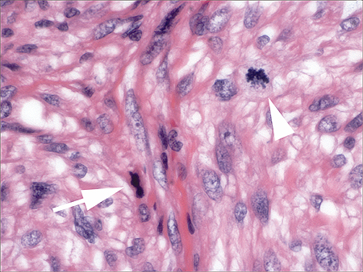
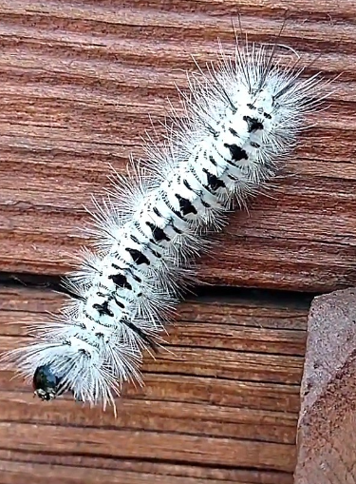
Mitotic Figure vs. Pyknotic Nucleus
Notes:
Which is in contrast to a pyknotic, presumably degenerating cell (arrow), without distinct chromosomes that also has hypereosinophilic cytoplasm, a feature often associated with degenerating cells. Another bona-fide mitotic figure is present for comparison (arrowhead).

Slide 53
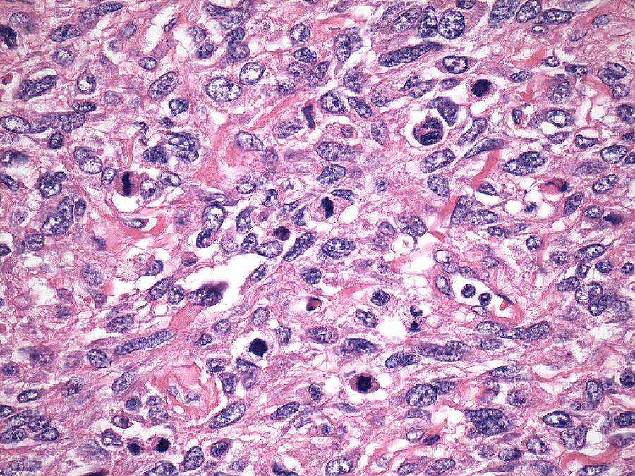
Notes:
Overestimating the number of mitoses could drastically overestimate proliferation and potentially effect the diagnosis. In this example, the cells marked by a yellow arrow I would consider mitotic figures – in some you can actually visualize the spindle apparatus - while those marked by a green arrow are NOT because one cannot visualize distinct chromosomes

Slide 54
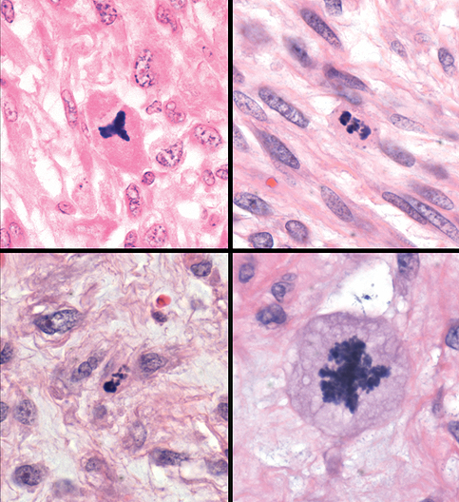
Atypical Mitotic Figures
Notes:
Another potential pitfall is the evaluation of atypical mitotic figures as their presence allows consideration of placement of the tumor into the category of SMTs with significant cytologic atypia regardless of the severity of atypia. Categorization as an atypical mitosis however can have a subjective component and one should be careful about what truly represents an atypical form. I look for metaphases with more than one spindle axis as seen in this tripolar mitosis OR anaphases in which individual chromosomes lag behind as they are drawn to the pole of their spindle apparatus. Also aneuploid metaphases in which there appear to be more chromosomes than one would expect in a diploid cell can be considered atypical; however this criterion is very difficult to apply and should be used judiciously.

Slide 55
Test Your Knowledge!

Slide 56
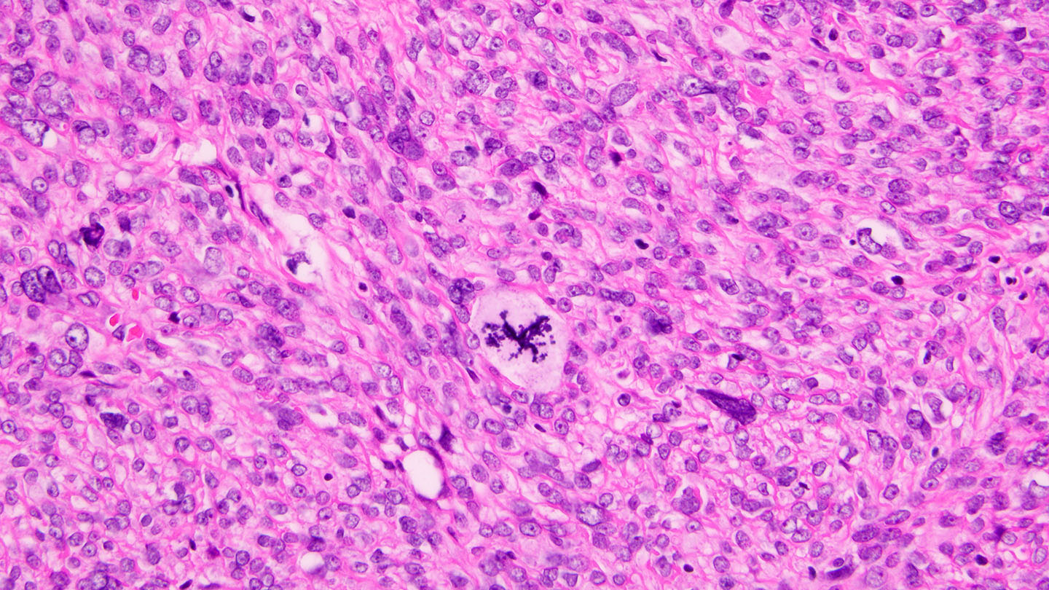
Atypical Mitosis – YES or NO?
Notes:
YES

Slide 57
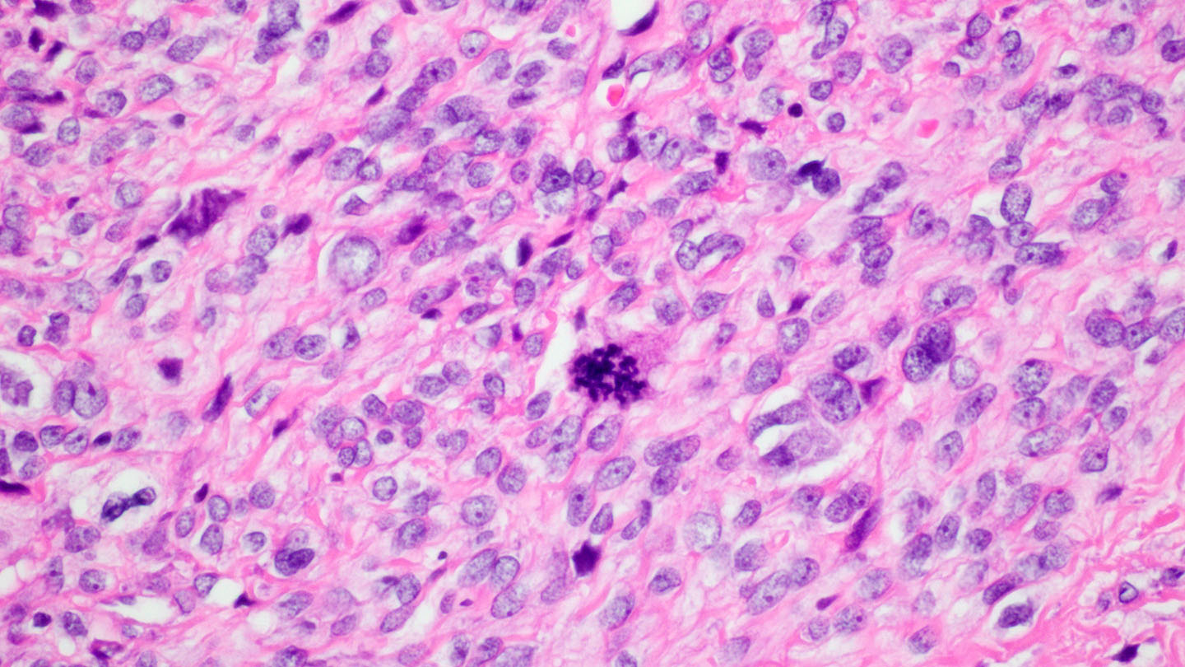
Atypical Mitosis – YES or NO?
Notes:
NO

Slide 58
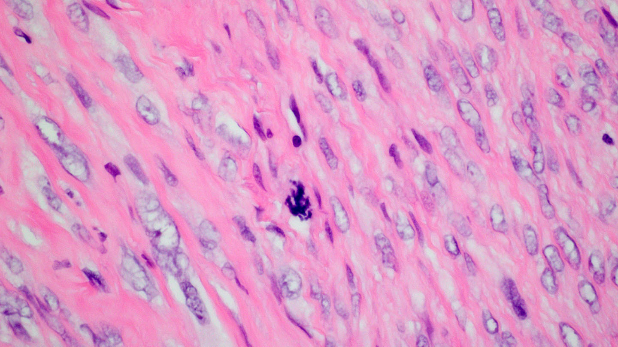
Notes:
YES

Slide 59
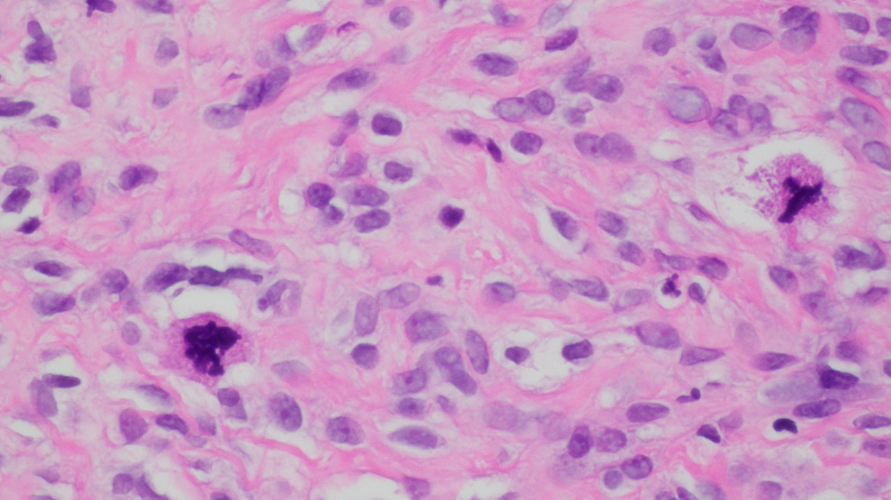
Notes:
NO

Slide 60
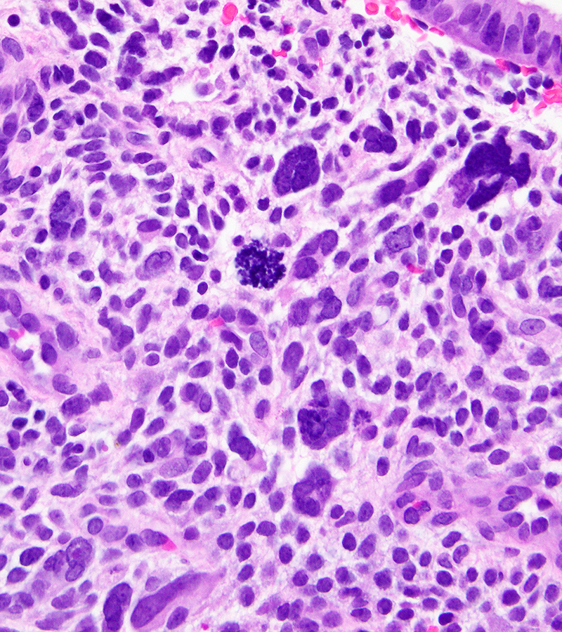
Ki67

Slide 61
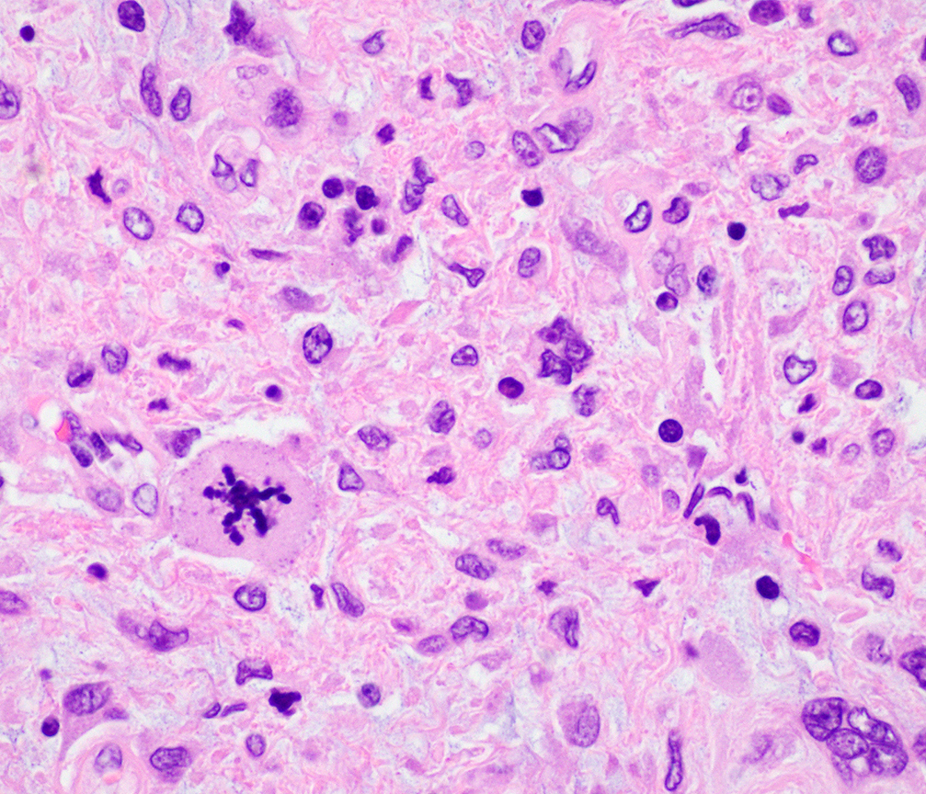

Slide 63
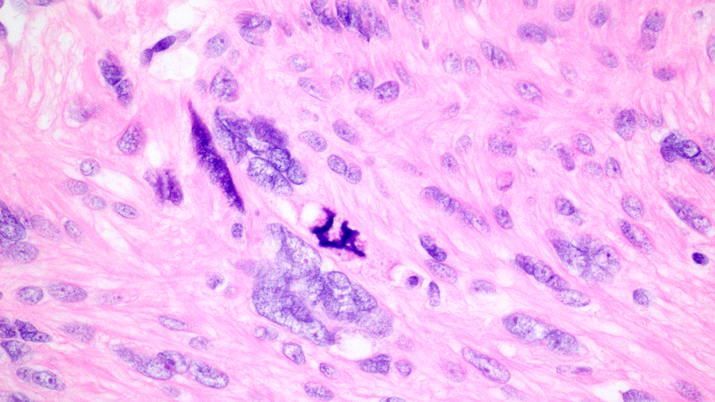

Slide 64
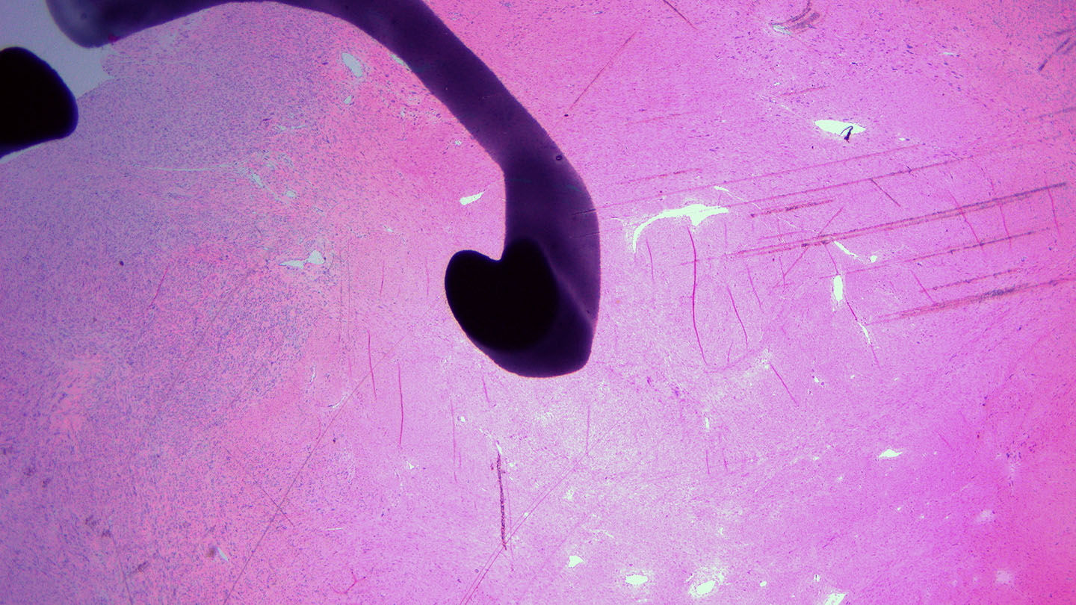

Slide 65
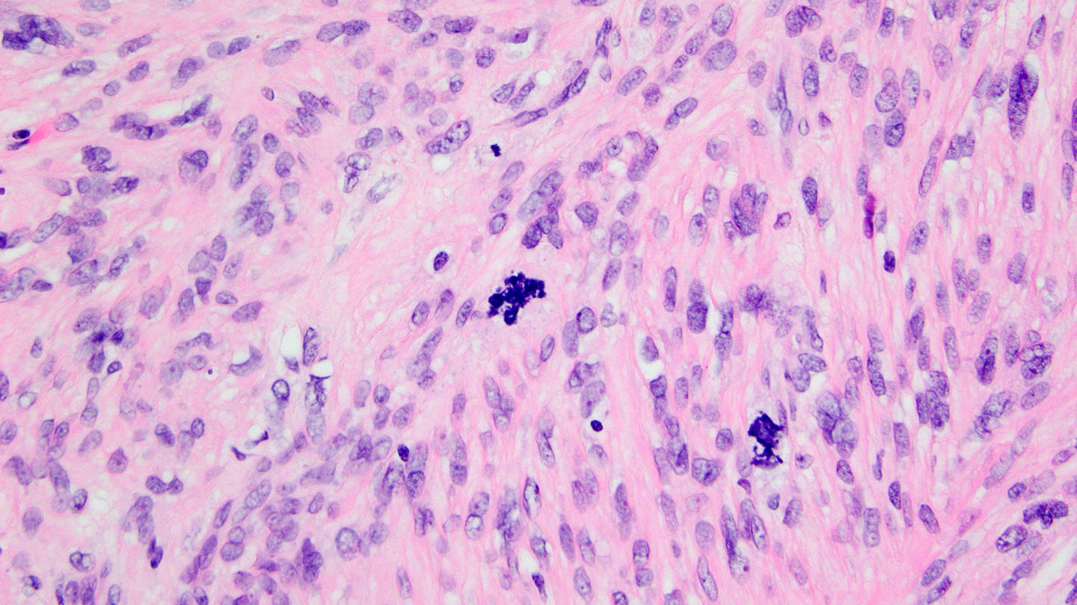

Slide 66
LEIOMYOSARCOMA

Slide 67
Pelvic recurrence 4 years later
Notes:
4 years later

Slide 68
Practical Points – When to be Concerned
Tumors with significant nuclear atypia (multifocal or diffuse) and sub-diagnostic mitotic rate (8 to 9 per 10 HPFs)
Atypical mitotic figures
Sampling (and careful scrutiny) is key!
Notes:
68

Slide 69
Practical Points
Cautiously survey at 10 (to 20X) to assess mitotic rate and look for “hotspots”
Consider Ki67 to look for “hotspots”
Notes:
69

Slide 70
Leiomyoma with bizarre nuclei (atypical leiomyoma, symplastic leiomyoma, leiomyoma with symplastic change)
“contain bizarre cells arranged in multifocal to diffuse distribution in a background of typical leiomyoma”
“the bizarre cells may be mononucleated or multinucleated and may have eosinophilic or globular cytoplasm, smudged chromatin, and nuclear pseudo-inclusions”
“mitotic activity is typically low (<5 per 10 HPF) but karyorrhectic nuclei, which may mimic atypical mitotic figures, are not uncommon”

Slide 71
LMS with leiomyoma-like areas

Slide 72
LMS with smudged nuclei

Slide 76
Case 2: Clinical History
A 30-year-old woman with uterine fibroids underwent myomectomy; the specimen consisted of a 500 gram aggregate of cylindrical pink-tan tissue

Slide 87
FH

Slide 88
FH

Slide 89
FH DEFICIENT LEIOMYOMA

Slide 90
Hereditary Leiomyomatosis Renal Cell Carcinoma (HLRCC)
In 1973, Reed et al. described two families that had coexisting cutaneous and uterine smooth muscle tumors (Reed syndrome)
Autosomal dominant pattern of inheritance, incomplete penetrance
Later, an association with papillary renal cell carcinoma (RCC) was discovered
Associated with germline heterozygous loss of function mutations in fumarate hydratase
Notes:
Kidney tumors less penetrant

Slide 91
HLRCC Lifetime Risk
Cutaneous Leiomyomas (~70%)
Uterine Fibroids (~80%)
Papillary Renal Cell Carcinoma (15-30%)
Lehtonen et al. J Med Genet. 2006.

Slide 92
Hereditary Leiomyomatosis Renal Cell Carcinoma
Leiomyomas from 19 patients with HLRCC
Leiomyomas were cellular or atypical leiomyomas
All have tumor cell nuclei with large eosinophilic macronucleoli surrounded by clear perinuclear halos
LOH at 1q43 frequent in HLRCC LM (~80%); coding sequence mutation/small deletions/promoter hyper-methylation other possible “2nd hits”
Sanz-Ortega et al. Morphology and Molecular Characteristics of Uterine Leiomyomas in HLRCC syndrome. Am J Surg Pathol 2013; 37:74-80

Slide 93
FH Deficient Leiomyomas
Other microscopic findings in addition to the macronucleoli with perinucleolar clear halos have been reported
Increased cellularity or nuclear atypia
Staghorn blood vessels
Eosinophilic cytoplasmic inclusions
Alveolar edema
Loss of FH protein can be detected by immunohistochemistry
Accumulated fumarate undergoes protein succination, reacting with cysteine to form S-(2-succino)-cysteine (2SC), which can be detected in the cytoplasm by immunohistochemistry (picks up abnormally functioning FH)
PMID 30741757; 26457356; 26457356; 31162287; 24309325
Notes:
Reyes C et al Uterine Smooth Muscle Tumors with features suggesting FH aberration; detailed morphologic analysis and correlation with 2SC immunohistochemistry. Modern Pathology 2013; 27(7): 1020-1027

Slide 94
Eosinophilic Cytoplasmic Inclusions

Slide 95
True or False?
If a smooth muscle tumor is FH-deficient, I don’t have to worry about malignant potential

Slide 96
True or False?
If a smooth muscle tumor is FH-deficient, I don’t have to worry about malignant potential
FALSE!

Slide 98
Criteria for Malignancy in an FH-deficient Smooth Muscle Tumor
Currently not well defined as there is “atypia” at base-line
Atypia and cellularity must be “more than in a typical FH-deficient leiomyoma”
Mitotic threshold usually much greater than 10 per 10 high power fields
Atypical mitoses
Infiltrative border

Slide 99
Evaluation of LM with Bizarre Nuclei (and other smooth muscle tumors with suggestive features)
Stain for FH and/or 2SC
If FH lost, consider the possibility of HLRCC. But, most will be due to somatic mutations.
If clinical history is suggestive (cutaneous LM or RCC in patient or family history of cutaneous LM, uterine LM at young age, RCC) consider referral to a genetic counsellor
If there are multiple LM with FH loss, possibility of HLRCC should be noted in report

Slide 100
Practical Points
Be wary of smooth muscle tumors with “significant” cytologic atypia → sample well, perform a careful mitotic count, evaluate for atypical mitotic figures
Consider an FH deficient smooth muscle tumor if appropriate morphologic features are present

Slide 101
Thank you!

